Slide 2
Lesson 3: Object Oriented Design (10hrs)
Writing contracts: Describing and Elaborating Use Cases
Collaboration Diagram and sequence diagram
Objects and Patterns (information expert, creator, low coupling, high cohesion, controller)
Determining Visibility
Class Diagram

Slide 3
Lesson 2: Object Oriented Analysis (10hrs)
The Analysis phase ends with finding out:
the Essential use cases that identifies the domain processes
the conceptual or domain model that identifies the concept classes or terms existing in the domain
the system sequence diagram that shows the system events and operations and contracts that shows what the system operations do.

Slide 4
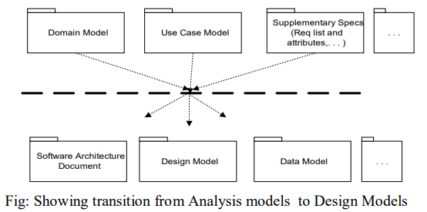
OOD

Slide 5
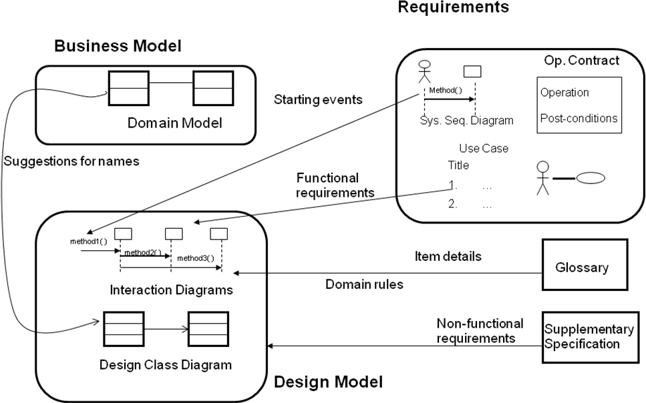
OOD

Slide 6
Object Oriented Design Inputs
Provided by the output of object-oriented analysis.
Both analysis and design can be performed incrementally, and the artifacts can be continuously grown instead of completely developed in one shot.
Analysis and Design can occur in parallel.
Some typical input artifacts for object-oriented design are:
Conceptual model
Use case
System Sequence Diagram
User interface documentations
Relational data model

Slide 7
Object Oriented Design Inputs
CONCEPTUAL MODEL
Conceptual model is the result of object-oriented analysis, it captures concepts in the problem domain.
The conceptual model is explicitly chosen to be independent of implementation details, such as concurrency or data storage

Slide 8
Object Oriented Design Inputs
USE CASE
Use case is a description of sequences of events that, taken together, lead to a system doing something useful.
Each use case provides one or more scenarios that convey how the system should interact with the users called actors to achieve a specific business goal or function.
Use case actors may be end users or other systems.
In many circumstances use cases are further elaborated into use case diagrams.
Use case diagrams are used to identify the actor (users or other systems) and the processes they perform.

Slide 9
Object Oriented Design Inputs
SYSTEM SEQUENCE DIAGRAM
System Sequence diagram (SSD) is a picture that shows, for a particular scenario of a use case, the events that external actors generate, their order, and possible inter-system events.

Slide 10
Object Oriented Design Inputs
USER INTERFACE DOCUMENTATIONS (if applicable)
Document that shows and describes the look and feel of the end product's user interface.
It is not mandatory to have this, but it helps to visualize the end-product and therefore helps the designer.

Slide 11
Object Oriented Design Inputs
RELATIONAL DATA MODEL (if applicable)
A data model is an abstract model that describes how data is represented and used.
If an object database is not used, the relational data model should usually be created before the design, since the strategy chosen for object-relational mapping is an output of the OO design process.
However, it is possible to develop the relational data model and the object-oriented design artifacts in parallel, and the growth of an artifact can stimulate the refinement of other artifacts.

Slide 12
Object Oriented Design Process
DEFINING OBJECTS, CREATING CLASS DIAGRAM FROM CONCEPTUAL DIAGRAM
Entities from the conceptual diagram are represented as classes in the class diagram.

Slide 13
Object Oriented Design Process
IDENTIFYING ATTRIBUTES
Define the properties or characteristics of classes in the class diagram.
Attributes provide details about the state of objects represented by the classes.

Slide 14
Object Oriented Design Process
USE DESIGN PATTERNS (if applicable)
Design patterns are reusable solutions to common problems in a given context.
Enhances code reusability and promotes best practices in design.
A design pattern is not a finished design, it is a description of a solution to a common problem, in a context.
It can also be thought of as a template for how to solve a problem that can be used in many different situations and/or applications.
Object-oriented design patterns typically show relationships and interactions between classes or objects, without specifying the final application classes or objects that are involved.

Slide 15
Object Oriented Design Process
DEFINE APPLICATION FRAMEWORK (if applicable)
Application framework is a term usually used to refer to a set of libraries or classes that are used to implement the standard structure of an application for a specific operating system.
Use an application framework to leverage pre-built, reusable code.
Saves time and effort by avoiding the need to rewrite standard functionalities for each new application.

Slide 16
Object Oriented Design Process
IDENTIFY PERSISTENT OBJECTS/DATA (if applicable)
Persistent objects/data are those that need to persist beyond a single runtime.
Identify classes that represent objects requiring long-term storage.
Design object-relational mapping (ORM) if using a relational database to ensure seamless data persistence.

Slide 17
Object Oriented Design Process
IDENTIFY AND DEFINE REMOTE OBJECTS (if applicable)
Remote objects are objects that exist on a different address space or system.
Identify classes that need to be accessed remotely.
Define communication protocols, such as Remote Method Invocation (RMI) or web services, for interaction.

Slide 18
Object Oriented Design Outputs
SEQUENCE DIAGRAMS/COLLABORATION/INTERACTION
Serves as Extension of System Sequence Diagram
Add specific objects to the System Sequence Diagram to handle system events.
Sequence diagrams depict parallel vertical lines representing processes or objects and horizontal arrows indicating the order of exchanged messages.

Slide 19
Object Oriented Design Outputs
DESIGN CLASS DIAGRAM
Captures the static aspects of the system.
Depicts the system's structure, including classes, attributes, and relationships.
Messages and classes identified in sequence diagrams can serve as input to the automatic generation of the global class diagram of the system.

Slide 20
Static and Dynamic Modeling
There are two kinds of object models: STATIC and DYNAMIC.
Static models, such as UML class diagrams,
help design the definition of packages, class names, attributes, and method signatures (but not method bodies)
Dynamic models, such as UML interaction diagrams sequence diagrams or communication diagrams,
help design the logic, the behavior of the code or the method bodies.
They tend to be the more interesting, difficult, important diagrams to create.

Slide 21
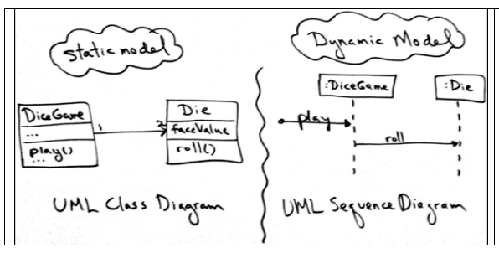
Static and Dynamic Modeling

Slide 22
Object Oriented Design Techniques
Class Responsibility Collaboration (CRC) Cards
A popular text-oriented modeling technique.
Are a brainstorming tool used in the design of object-oriented software
CRC cards are paper index cards on which one writes the responsibilities and collaborators of classes.
Each card represents one class.
A CRC modeling session involves a group sitting around a table, discussing and writing on the cards as they play "what if" scenarios with the objects, considering what they must do and what other objects they must collaborate with.

Slide 23
CRC Cards
CRC cards are usually created from index cards on which are written:
The class name
Its Super and Sub classes (if applicable)
The responsibilities of the class.
The names of other classes with which the class will collaborate to fulfill its responsibilities.
Author

Slide 24
CRC Cards
Class Name
Responsibilities | Collaborators
Student
Student Number Name Address Phone Number Enroll in a seminar Drop a seminar Request Transcripts | Seminar
Fig. CRC Card Format
Fig. CRC Card Example

Slide 25
CRC Cards - Class
A Class represents a collection of similar objects.
Objects are things of interest in the system being modeled.
They can be a person, place, thing, or any other concept important to the system at hand.
The Class name appears across the top of the CRC card.

Slide 26
CRC Cards - Responsibility
A Responsibility is anything that the class knows or does.
These responsibilities are things that the class has knowledge about itself, or things the class can do with the knowledge it has.
For example, a person class might have knowledge (and responsibility) for its name, address, and phone number.
In another example an automobile class might have knowledge of its size, its number of doors, or it might be able to do things like stop and go.
The Responsibilities of a class appear along the left side of the CRC card.

Slide 27
CRC Cards - Collaborator
A Collaborator is another class that is used to get information for or perform actions for the class at hand.
It often works with a particular class to complete a step (or steps) in a scenario.
The Collaborators of a class appear along the right side of the CRC card

Slide 28
How do you create CRC models
Find classes.
Finding classes is fundamentally an analysis task because it deals with identifying the building blocks for your application.
A good rule of thumb is that you should look for the three-to-five main classes right away, such as Student, Seminar, and Professor in Figure .
Find responsibilities.
You should ask yourself what a class does as well as what information you wish to maintain about it.
You will often identify a responsibility for a class to fulfill a collaboration with another class.

Slide 29
How do you create CRC models
Define collaborators.
A class often does not have sufficient information to fulfill its responsibilities.
Therefore, it must collaborate (work) with other classes to get the job done.
Collaboration will be in one of two forms: a request for information or a request to perform a task.

Slide 30
How do you create CRC models
Move the cards around.
To improve everyone’s understanding of the system, the cards should be placed on the table in an intelligent manner.
Two cards that collaborate with one another should be placed close together on the table
Whereas two cards that don’t collaborate should be placed far apart.

Slide 31
Use Case Realization
A use-case realization represents how a use case will be implemented in terms of collaborating objects.
This artifact can take various forms.
It can include, for example,
a textual description (a document),
class diagrams of participating classes and subsystems, and
interaction diagrams (communication and sequence diagrams)
that illustrate the flow of interactions between class and subsystem instances.

Slide 32
Use Case Realization
The reason for separating the use-case realization from its use case is that doing so allows the use cases to be managed separately from their realizations.
This is particularly important for larger projects or families of systems where the same use cases can be designed differently in different products within the product family.
For larger projects, separating the use case and its realization allows changes to the design of the use case without affecting the baseline use case itself.
In a model, a use-case realization is represented as a UML collaboration that groups the diagrams and other information (such as textual descriptions) that form part of the use-case realization.

Slide 33
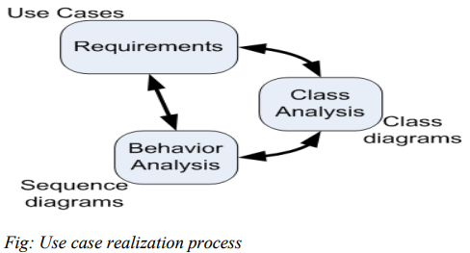
Use Case Realization
Use case realization : Make sure that the sequence diagrams realize (show) the behavior outlined in the use cases and assign behavior to classes in the class diagram. Together, these three continue to evolve and sharpen each other. This can be shown as following fig:

Slide 34
Use Case Realization
Example Use Case: "Place an Order" for an Online Shopping System
Prepare a Use Case Description

Slide 35
Use Case Realization
Title: Place an Order Primary Actor: Customer Preconditions: Customer is logged in and has items in the shopping cart. Postconditions: Order is placed, payment is processed, and confirmation is sent to the customer. Main Success Scenario:
Customer reviews the items in the shopping cart.
Customer provides shipping information.
Customer provides payment information.
System validates the payment.
System confirms the order and updates inventory.
System sends order confirmation to the customer.

Slide 36
Use Case Realization
Identify the Actors and Use Cases
Actors:
Customer
Payment Gateway (external system)
Inventory System (internal system)
Use Cases:
Review Cart
Enter Shipping Information
Enter Payment Information
Validate Payment
Confirm Order
Update Inventory
Send Order Confirmation

Slide 37
Use Case Realization
Customer Online Shopping System Payment Gateway Inventory System | | |---> Review Cart ------>| | | | | | | |---> Enter Shipping Info| | | | | | | |---> Enter Payment Info | | | | |------ Validate Payment ------>| | | |<----- Payment Validated -------| | | | | | | |------ Confirm Order --------------------------->| | |<----- Order Confirmed ---------------------------| | | | | | |------ Update Inventory ------------------------>| | |<----- Inventory Updated ------------------------| | | |<--- Send Order Confirmation --------------------| | | | | |

Slide 38
Object Design Techniques
CRC Cards:
Principle:
Collaboratively define classes, their responsibilities, and collaborations.
Technique:
Use index cards for each class, list responsibilities, and note collaborations with other classes.
Facilitates brainstorming and discussion in a team.
Use Case Realization:
Principle:
Connecting use cases to the classes that implement them.
Technique:
Identify how each use case is realized or implemented by the classes in the system.
Specify the collaboration and interactions between classes to fulfill the behaviors defined in use cases.

Slide 39
CRC Practical: Designing Social Media
Objective:
To apply CRC cards for designing a simplified social media platform using object-oriented principles.
Welcome, everyone! Today, we're diving into the exciting world of software design, and our focus is on creating a social media platform. Imagine having the opportunity to shape the next big thing in the digital space where users connect, share, and interact.
Context: The Social Media Revolution
In recent years, social media platforms have become an integral part of our daily lives. From sharing photos and updates to connecting with friends, family, and even making new connections worldwide, social media has transformed how we communicate.

Slide 40
CRC Practical: Designing Social Media
To apply CRC cards for designing a simplified social media platform using object-oriented principles.
Your Challenge: Designing a Social Media Platform
Now, picture yourselves as the brilliant minds behind a groundbreaking social media platform. Your task is to design the backbone of this digital space, where users can seamlessly connect, share content, express themselves, and engage with others.
Use powerful design technique called CRC cards. CRC stands for Class-Responsibility-Collaboration, and these cards will help us define the fundamental building blocks of our system – the classes, their responsibilities, and how they collaborate with one another.

Slide 41
CRC Practical: Designing Social Media
To apply CRC cards for designing a simplified social media platform using object-oriented principles.
Classes: The Digital Entities
Think of classes as the digital entities that make up our social media platform. These could include Users, Posts, Comments, Likes, Friends, and more. Each class plays a specific role in ensuring the platform's functionality.
Responsibilities: What Each Class Does
Responsibilities define the tasks and functions that each class is responsible for. For example, a User class might be responsible for creating posts and managing their friends.

Slide 42
CRC Practical: Designing Social Media
To apply CRC cards for designing a simplified social media platform using object-oriented principles.
Collaboration: How Classes Work Together
Collaboration illustrates how different classes interact and work together to achieve specific tasks. For instance, the Post class might collaborate with the User class to associate posts with specific users.

Slide 44
PREVIEW FOR LECTURE 9
COLLABORATION/COMMUNICATION DIAGRAM

